Slide 1
Domestic violence impacts on children
Notes:
1

Slide 2
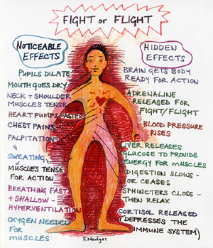
Impacts on children
Trauma effects on
brain development
Notes:
The effects of scary and traumatic events on very young babies and on the unborn child
This is most important to explain to parents where:
• the domestic violence was going on when the child was in utero or in the ﬁrst two years of life and
• the child is now showing poor concentration/has been diagnosed with attention deﬁcit hyperactivity disorder (ADHD)/seems very fearful/is quick to anger/is very frozen/desensitised.
Human beings are born ‘undercooked’ compared with many other mammals. We are very dependent on our parents for a much longer period than other animals, some of whom hit the ground and almost immediately start walking about. This ‘half-cookedness’ goes beyond the physical development of the
62
THE IMPACT OF DOMESTIC VIOLENCE ON CHILDREN
human baby and is also true in terms of our brain development. The hard- wiring of our brains is still forming in the ﬁrst 18 months of life, and the brain circuits and systems are being shaped by early experiences. The systems that are most used at that time become the most emphasised and most active thereafter. This includes our overall stress-response system, which includes the basic ‘ﬂight-ﬁght-freeze’ responses to threatening events.
We can imagine the baby being born, and, like all animals, scanning the environment for potential threats. If a baby is repeatedly frightened or exposed to shocks, the stress response system can end up becoming over-active, with the result that the baby can become frozen, jumpy or seem angry and hard to manage.
In schoolchildren the jumpiness and poor concentration can often lead to a diagnosis of ADHD. In teenagers we see that some young people have lower
‘stimulus-response thresholds’ than others. Some get much angrier at seemingly small provocations, or are much more nervous and fearful. Their adrenalin seems to be pumping already in situations where others may still feel calm. This makes it harder for them to deal with anger without hitting out. But of course, although it is hard, they can learn to calm themselves down or to express their anger in other ways.

Slide 3
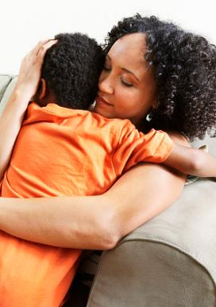
Soothing and calming your child
Don’t react back with anger
Get them to breathe very slowly in and out 5 times – counting backwards from 5
Encourage them to use their words and label their feelings – you can say “maybe you’re feeling ….”
Listen - Check back what you’ve heard and keep adjusting until they agree you’ve heard them right
When they are a little calmer you can start looking at problem solving

Slide 4
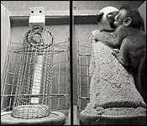
Impacts on children
Attachment styles
Notes:
The effects of domestic violence on infants and on the development of their ways of bonding in close relationships (attachment styles)
This is most important to explain to parents where:
• the domestic violence was happening when the child was an infant from
0 to 3 years old or where it persisted for many years and
• the child appears very needy, clingy and hard to comfort or is very cut off and over-independent.
Our attachment style is the way we bond with and relate to very close others
– like parents and, later on in life, girlfriends and boyfriends. It seems that we all develop a pattern or template for this in the ﬁrst two years of life and that it is based largely on the relationship we had then with our main carer (usually our mum).
Note: This is a way to give a simple and graphic explanation of this important idea – a sort of Blue Peter demonstration of attachment theory. You’ll need a jug of water, a drip tray of some sort, a couple of bits of cling ﬁlm and two plastic cups – one perforated with little holes.
Explain to the parent you are working with that the jug represents the mother and the cup represents the baby. The baby has many needs and discomforts that cause it to cry. Mum tries to meet the baby’s needs and when she gets it
63
PICKING UP THE PIECES AFTER DOMESTIC VIOLENCE
right (for example, by giving a hungry baby a feed) the baby is sated and stops crying. It feels understood and satisﬁed. We can say that an amount of ‘loving- kindness-security’ has gone from mother to baby. And, of course, the cessation of crying is a big relief to mum, who feels validated as a result. In this way, some of the loving-kindness has passed back from baby to her.
To demonstrate this, say that the water represents this ‘loving-kindness- security’, and pour a bit from the jug to the cup and then a part of that back again from cup to jug as you move through the narrative; demonstrate the various stages by pouring water back and forth, or spilling it at the appropriate times.
Over time and with these repeated interactions, baby gets more and more full of security and loving kindness, which continues to pass to and fro between baby and mum. Scary events, like falling over, can make a little bit spill out but baby learns that mum will quickly be there to offer comfort and top up the loving- kindness-security again. Eventually, the baby’s expectation of receiving comfort when it is needed, and the sense of being full enough of good stuff to risk a little spill here and there, serve to form a safe base. This sense of security allows the infant to venture further and further from mum and out into the world.
This way of relating in which both people are open to the other’s love and comfort, but also ‘full enough’ to feel secure and to move away for periods to explore the world, is called secure attachment. Some boyfriends and girlfriends operate in a similar way – they can show and meet each other’s neediness but are also pretty secure and outward-facing much of the time.
In those early years it’s ﬁne for mum not to always immediately meet her baby’s needs. She can afford to get it wrong sometimes, or take her time to get it right sometimes, so long as she then comforts the baby and ‘repairs’ the baby’s distress. She only needs to get it right around 40 per cent of the time for secure attachment to result (according to Mary Maine).9 [AQ]
But when very frightening things happen, like a violent argument, a lot of the security is spilled out. This is when the baby has a huge need for comfort, and when baby’s attachment needs are highest. If mum or dad respond in a frightened or frightening way (like they might in the middle of a heated scary row), this doesn’t have to happen very often to damage the secure attachment. Unable to bear the high level of non-comforted distress, no longer safe in the knowledge that what is spilled will be quickly replaced, babies have to ﬁnd their own way to get and hold some securing loving-kindness.
One choice is to hold in whatever is left there to protect their soft and vulnerable insides – this is like putting cling ﬁlm over the cup (put a piece of cling ﬁlm over the cup to demonstrate). But now it is harder for baby to take in love – s/he is too defensive. And so it is harder for mum’s love to go in and for baby’s love to come back. This is painful for mum too, and she may little by little close off herself also (demonstrate this by also covering the jug with cling ﬁlm). Mum will experience this as a difficulty in bonding with her child and it The effects of domestic violence on infants and on the development of their ways of bonding in close relationships (attachment styles)
This is most important to explain to parents where:
• the domestic violence was happening when the child was an infant from
0 to 3 years old or where it persisted for many years and
• the child appears very needy, clingy and hard to comfort or is very cut off and over-independent.
Our attachment style is the way we bond with and relate to very close others
– like parents and, later on in life, girlfriends and boyfriends. It seems that we all develop a pattern or template for this in the ﬁrst two years of life and that it is based largely on the relationship we had then with our main carer (usually our mum).
Note: This is a way to give a simple and graphic explanation of this important idea – a sort of Blue Peter demonstration of attachment theory. You’ll need a jug of water, a drip tray of some sort, a couple of bits of cling ﬁlm and two plastic cups – one perforated with little holes.
Explain to the parent you are working with that the jug represents the mother and the cup represents the baby. The baby has many needs and discomforts that cause it to cry. Mum tries to meet the baby’s needs and when she gets it
63
PICKING UP THE PIECES AFTER DOMESTIC VIOLENCE
right (for example, by giving a hungry baby a feed) the baby is sated and stops crying. It feels understood and satisﬁed. We can say that an amount of ‘loving- kindness-security’ has gone from mother to baby. And, of course, the cessation of crying is a big relief to mum, who feels validated as a result. In this way, some of the loving-kindness has passed back from baby to her.
To demonstrate this, say that the water represents this ‘loving-kindness- security’, and pour a bit from the jug to the cup and then a part of that back again from cup to jug as you move through the narrative; demonstrate the various stages by pouring water back and forth, or spilling it at the appropriate times.
Over time and with these repeated interactions, baby gets more and more full of security and loving kindness, which continues to pass to and fro between baby and mum. Scary events, like falling over, can make a little bit spill out but baby learns that mum will quickly be there to offer comfort and top up the loving- kindness-security again. Eventually, the baby’s expectation of receiving comfort when it is needed, and the sense of being full enough of good stuff to risk a little spill here and there, serve to form a safe base. This sense of security allows the infant to venture further and further from mum and out into the world.
This way of relating in which both people are open to the other’s love and comfort, but also ‘full enough’ to feel secure and to move away for periods to explore the world, is called secure attachment. Some boyfriends and girlfriends operate in a similar way – they can show and meet each other’s neediness but are also pretty secure and outward-facing much of the time.
In those early years it’s ﬁne for mum not to always immediately meet her baby’s needs. She can afford to get it wrong sometimes, or take her time to get it right sometimes, so long as she then comforts the baby and ‘repairs’ the baby’s distress. She only needs to get it right around 40 per cent of the time for secure attachment to result (according to Mary Maine).9 [AQ]
But when very frightening things happen, like a violent argument, a lot of the security is spilled out. This is when the baby has a huge need for comfort, and when baby’s attachment needs are highest. If mum or dad respond in a frightened or frightening way (like they might in the middle of a heated scary row), this doesn’t have to happen very often to damage the secure attachment. Unable to bear the high level of non-comforted distress, no longer safe in the knowledge that what is spilled will be quickly replaced, babies have to ﬁnd their own way to get and hold some securing loving-kindness.
One choice is to hold in whatever is left there to protect their soft and vulnerable insides – this is like putting cling ﬁlm over the cup (put a piece of cling ﬁlm over the cup to demonstrate). But now it is harder for baby to take in love – s/he is too defensive. And so it is harder for mum’s love to go in and for baby’s love to come back. This is painful for mum too, and she may little by little close off herself also (demonstrate this by also covering the jug with cling ﬁlm). Mum will experience this as a difficulty in bonding with her child and it
also may make her feel very guilty. This is called avoidant attachment. ‘Avoidant’ kids don’t seem so affected by the traumas around them. They may be watching TV or playing while arguments rage between their parents. People often feel reassured by this but these children may develop into adults who can’t easily accept love and comfort or allow themselves to be close to or show their needs to others. In relationships they often feel their space being infringed upon and want their girlfriend or boyfriend to back off. They may ﬁnd other people’s needs hard to tolerate – even their own children’s neediness.
Another choice a baby has to get more loving-kindness is to become more open – more porous. That way that baby can soak up good attention from everywhere (equivalent to perforating a cup). But of course when love is received it can’t really be held onto – the baby leaks security (pour water into the leaky cup to demonstrate). This is called anxious attachment. S/he is clingy, very hard to comfort and very distressed when separated from mum but also may be very open to affection from anyone – even relative strangers. As adults, anxiously attached people are needy, very nervous about their partners leaving them and often quite jealous and ‘co-dependent’. They tend to be very ‘inward-facing’ in their relationships.
Most difficult as an attachment style is actually a mixture of both these – called disorganised attachment. The baby can be too ‘leaky’ at moments and too closed off at others. Not only can loving-kindness hardly get in but, if it does, it is hard for baby to hold onto. Children with disorganised attachment may grow up to have real problems with relationships later because they both fear abandonment and get jealous, at the same time as being unable to bear it when their girlfriend or boyfriend gets too close. They constantly feel the need to pull their partner closer then push them away.
Many of us grow up with some degree of anxious or avoidant attachment in our way of relating to others. But repeated exposure to domestic violence can cause children to develop more extreme versions of these styles of relating. And we need to know that, if our children are already showing signs of one of these, then:
• it is possible to turn it around
• but it isn’t quick to turn it around, particularly the older and more ‘hard- wired’ the child.
You can demonstrate how a parent may have to do a lot of ‘pouring’ love and comfort into the child without much coming back (here make a little hole in the cling ﬁlm over the cup and try to pour water from the jug into it – not a lot goes in, and none comes back) – before the avoidant child begins to take down its defences (gradually expand the hole in the cling ﬁlm so more water goes in) or the anxious child starts to shore up its boundaries (here wrap some cling ﬁlm round the perforated cup so it holds water). Only then will mum and dad get
65
PICKING UP THE PIECES AFTER DOMESTIC VIOLENCE
much back for their efforts. And it can really take years of painstaking loving despite no apparent changes before you get there (experts tell us to expect two to ﬁve years).

Slide 5
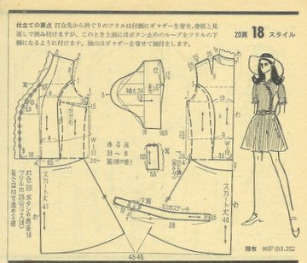
Attachment style – a template for doing close relationships
Early experiences (in the first 2years) are powerfully predisposing. Thereafter our style is robust and hard (not impossible) to change.
Why is this?

Slide 6

The carer responds to the baby’s signals of need and distress. This pattern of signal and response is like the first small stream forming. At this point the course it takes is open and it’s easy to redirect.

Slide 7

With every repetition of the pattern is strengthened. The interactions between baby and carer begins to take a course which is still tentative - but which now predisposes each successive response.

Slide 8

Over time, with consistent reinforcement, the stream becomes a deep river.

Slide 9

And it gets harder and harder to change its course….

Slide 10
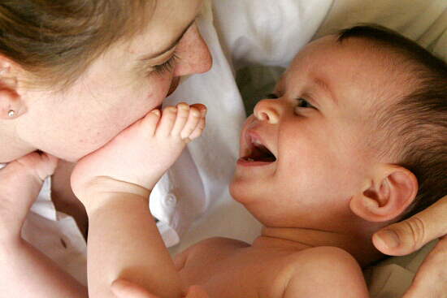
Getting more secure
What things do mothers do with young children in the first 2 years to make them feel safe and secure?
Notes:
Attachment promoting behaviours include the following at any age:
Consistency
Giving attention, so that the child feels loved recognised and important
Comforting
Naming difficult feelings for the youngster
Touch, cuddles, ‘containment’
10

Slide 11
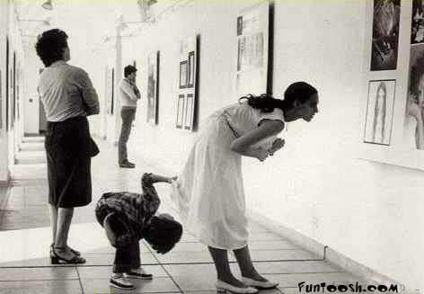
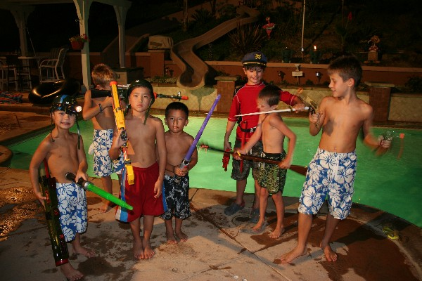
Impacts on children
Social learning
Notes:
The effects of domestic violence on what children learn about the way the world works
Explain that by witnessing domestic violence, children can learn that it is a normal or acceptable way to settle conﬂicts, and that if you aren’t the abuser you will be the abused. Those of us who learn this might ‘kick off’ whenever we feel angry or are involved in a disagreement. Some of us end up being victims ourselves later and thinking this is normal. Others of us again learn that conﬂict is dangerous – potentially catastrophic – and we avoid it at all costs throughout life, trying over-hard to please others.
Children also absorb their knowledge of relationships from seeing how their mum and dad behave with each other.
For a parent discussing domestic violence with children, it is important not to make light of the abuse in any way, and not to make excuses (e.g. ‘Daddy is ill’). Parents need to explain that the abuse was wrong and serious. Equally, parents need to understand clearly and explain to the children that exposing them to ongoing violence is also emotional abuse of them. Even if abused parents are struggling to prioritise their own safety, they do not have the right to impose domestic violence on their children. Parents should encourage their children to be clear about the boundaries they should set in life and expect others to respect.
11

Slide 12
Domestic violence and family dynamics
♂
♀
♂
♂
♀
Ω
Ω
Ω
♀
♀
Ω
Ω
♀

Slide 13
Post-separation family dynamics
There’re a power vacuum
This is often how the power differential ends up
This is what we need to return the power relationship to

Slide 14

Who’s in charge?
How does a parent establish themselves back in the parenting role without using fear and abuse?
Notes:
Consistency
Boundaries for children’s behaviour
Boundaries for yourself – you’re not your child’s mate – what is not appropriate? (eg. Breaking down on them, swearing at them, name calling them, sulking and guilt-tripping them, using them to talk out your problems with dad or other ‘adult issues’, putting down dad, getting them to keep secrets for you unless vital for safety, not doing sexual things around them etc etc)
14

Slide 15

Children’s Resilience
    protective factors against adversity
Self esteem
Talents
Child’s ability to make sense of events
Child’s relationships with others
supportive peer network
Sense of autonomy and purpose
Secure attachments to at least one parent
Connections to wider community
Sense of control

Slide 16
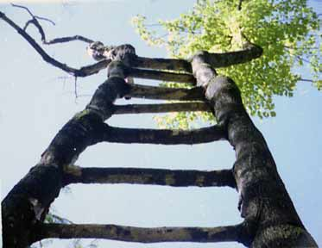
Supporting Resilience
contact with lots of supportive adults who know about what’s happened and will offer tonnes of love
permission to talk to others freely
contact with peers who’ve gone through similar
the best possible relationship from now on with both parents
anything that increases their self-esteem – extra-curricular activities, running clubs, drama shows etc.
getting therapy or specialist help to
  understand and express themselves better.
Mum and dad give a clear understanding
  of what happened and why – no excuses
Mum and dad get support to
  understand and parent them.
Helping others through voluntary
  work, mentoring etc.
Having a safety plan so they have
  some control over their safety if it
  happens again.
Notes:
16
Resilience
While it is vital for parents to be aware that living with conﬂict and aggression is harmful to children, there is a danger that, if we focus solely on the harm caused, we may foster a sense of hopelessness and a belief that their children’s lives have been damaged beyond repair. This could lead to parents feeling powerless to bring about positive changes in their children’s lives. The truth is that, while the children will deﬁnitely be affected by exposure to domestic violence, many children who grow up in very difficult circumstances go on to have happy and productive lives. There has also been a lot of research on the factors that help children through difficult times. The most important message is that, once the abuse stops, the healing can start.
Things that help children come through the experience well, despite having lived with domestic violence, are:
• parents being insistent that they don’t argue or have serious discussions when the children are around
• contact with lots of supportive adults who know about what has happened and will offer love
• permission (especially from parents) to talk to others freely
• contact with peers who’ve gone through similar things
• the best possible relationship from now on with both parents
• parents who, if separated, can manage a functioning relationship (not necessarily friendship)
anything that increases their self-esteem – extra-curricular activities, running clubs, drama shows, etc.
• getting therapy or specialist help to understand and express themselves better – or just have someone to talk to where they don’t have to be
‘diplomatic’
• mum and dad giving them a clear explanation of what happened and why – with no excuses
• mum and dad getting support to understand and parent the kids
• helping others through voluntary work, mentoring, etc.
• having a safety plan so they have some control over their safety if domestic violence happens again.

